Slide 1

Patient Adherence System
Driving Meaningful Medication Adherence

Slide 2
Problem and Impact
Poor Medication Adherence is a Problem of Striking Magnitude
32M use 3+ medications per day
75% non‐adherent in some way
Non‐adherence is related to
1/3 of medication‐related to hospitalizations
125,000 deaths annually
Annual US impact estimated at ~$300B
Addressing non‐adherence could cover the
cost of healthcare for ~45M
157M people will have one or more chronic
conditions in 2020, most of which will be
treated with medications.
American College of Cardiology
New England Healthcare Institute. ‘Thinking outside the pillbox via Healthcare insights; Express Scripts Lab;

Slide 3

Solving this big problem
Personalized Interventions, Offers and Rewards
No single approach has been shown effective across all people, conditions and settings Need to be tailored to the risks, characteristics and circumstances of individuals
New Health System Capabilities
Accurately assess and predict who is most at‐risk - Who is at risk for an adverse event in the near term? Identify what influencers of adherence differ for different people - What data‐driven factors are materially affecting adherence levels? Match people’s risk with tailored interventions - How can we adjust programs to target people based on different risk levels?

Slide 4
How it works?
Meet Mary
PROFILE
Mary is 41 years old
Has chronic back pain
Has been prescribed daily medications for 6 months.
Patient– Medication Interaction
RECORD
ANALYZE
PRESCRIBE
COMMUNICATE
ENGAGE
Medications
Pharmacy
COMMITMENT
Mary buys the medicine from the pharmacy and
As part of her buy she provides basic data about prescription and herself to the pharmacy
System records the data and feeds it to the Patient adherence system to store and compare her medicine purchase data.
System detects her adherence based on her purchase history and other patients data.
When the system detects that Mary is non adhering it raises a trigger to engage her by promotions & offers based on her engagement.
Mary is back to adherence and overall healthcare experience is improved manyfolds.

Slide 5
Solution – Demo

Slide 6
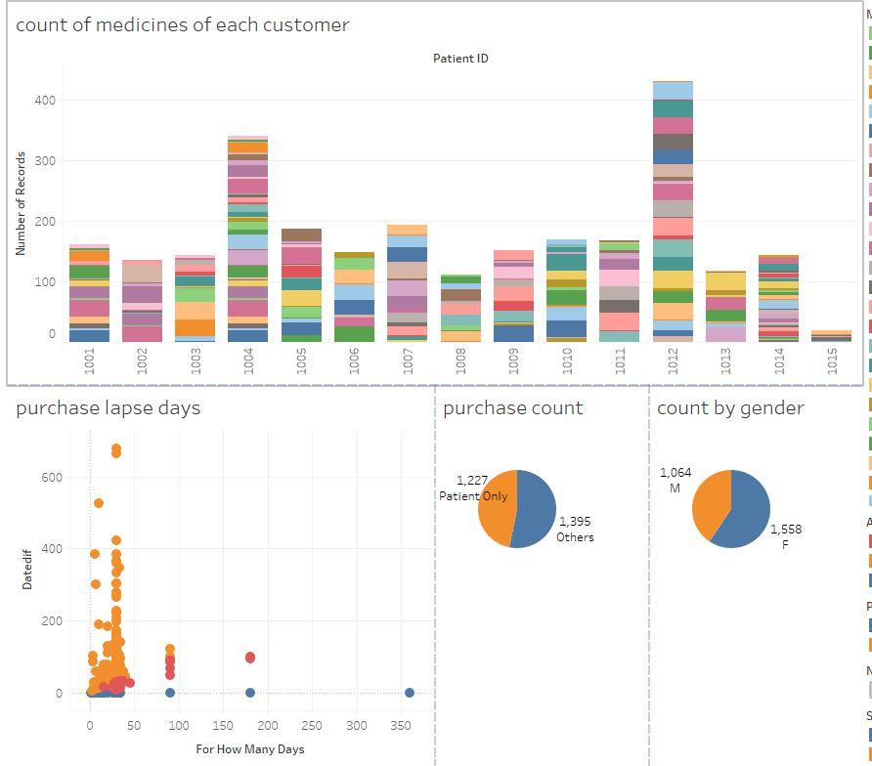
A glance at raw data
Features
Patient ID
Medication
Age
Gender
Date
Pharmacy
Purchased By
RETAIL/MAIL
For_How_Many_Days
Quantity

Slide 7
Data Engineering done
Problem at hand
The client needs a model that can account for the risk of non-adherence per patient and predict if the patient is likely to non-adhere and what factors affect the non-adherence.
Analytics Solution Framework Implemented
1. Data Preprocessing – Imputation & type conversion
2. Derive Features based on existing ones
8. Finalize the Model for the best fit
3. Plotting and Visualizing the data
7. Compare accuracy and results of various models
4. Get Insights and document them
5. Enrich data based on the Insights
6. Freeze data frame to feed into models

Slide 8
Important conclusions
Derived fields
PurchaseLapseDays
This field is just another representation for PurchasedAfter field but this field will specifically highlight by how many days the purchase has been lapsed. A positive number means that the purchase has been lapsed by so many days and a negative value means that the patient has refilled the medicine so many days before they ran out.
Adherence
This is a simple binary categorical representation of the adherence of the patient in that particular purchase. This is 0 (Non-Adherent) for a positive PurchaseLapseDays and 1 (Adherent) otherwise.
Classification Models(Multinomial Logistic Regression and RandomForest):
To find if a patient has low risk or high risk adherence levels based on purchase pattern until today.
The classification model with some accuracy will also be able to predict adherence levels for new patient based on the demographic attributes.

Slide 9
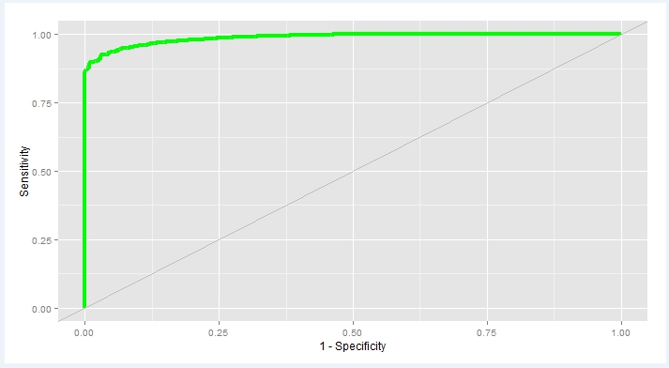
Model output results
Logistic Regression Results
Our Logistic Regression model predicts adherence class of a patient with approximately 92.14% accuracy for the “Test” data
Data | Accuracy | Precision | Recall
Train | 99.78955 | 21.51766 | 4.638713
Test | 92.14 | 34.87873 | 5.905822
Classification results using Randomforest Regression
Data | Accuracy | Precision | Recall
Train | 99.88522 | 96.97802 | 97.8517
Test | 98.18 | 96.05978 | 96.5847
Our Randomforest Regression model predicts adherence class of a patient with approximately 98.18 % accuracy for the “Test” data
By looking at the Precision and Recall results we can say that the prediction of True positives and True Negatives is reasonably good and ROC curve also depicts this.

Slide 10
Impact
Pharma Co’s
Throttle overall sales.
Increased customer engagement
Limit risk
Flexibility to scale up
Patients
Improved overall quality of healthcare.
Mitigate chronic disease risk.
Improved lifestyle by interventions.

Slide 11

End to End Patient Adherence System

Slide 12
Appendix

Slide 13
Feature Engineering
Data Wrangling
Imputation
While analyzing the data we found out there is only one NA present in the data. Just by looking the below and above numbers we came to the conclusion that its value has to be 205 and hence it has been replaced with 205
Data Types
Patient ID has been changed to factor
Date field has been changed to Date data type
Age has been binned into buckets of 10 years each. In the given data set, there will be only four levels for age now.
Derived fields
The following columns and data frames have been derived from master dataset for processing purpose.
PurchasedAfter
This filed holds the value for the number of days after which the next batch of medicines are bought.
PurchaseLapseDays
This field is just another representation for PurchasedAfter field but this field will specifically highlight by how many days the purchase has been lapsed. A positive number means that the purchase has been lapsed by so many days and a negative value means that the patient has refilled the medicine so many days before they ran out.
Adherence
This is a simple binary categorical representation of the adherence of the patient in that particular purchase. This is 0 (Non-Adherent) for a positive PurchaseLapseDays and 1 (Adherent) otherwise.
Adherence.Level
The adherence percentage for a given patient and medication combination till date
Adherence.Class
A High-Risk or Low-Risk classification of a patient based on the overall purchase adherence till date

Slide 14
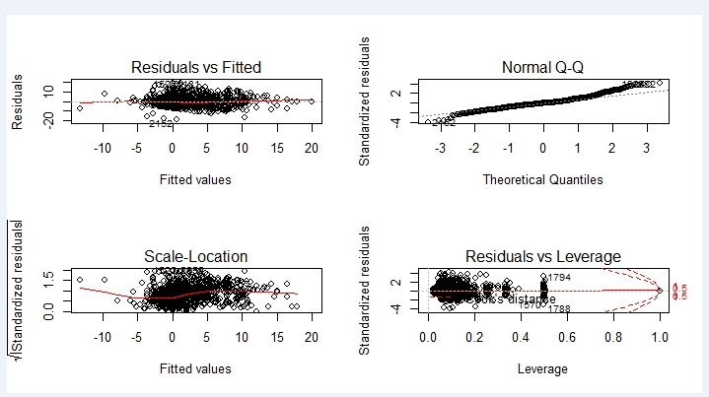
Adherence Behavior
The below plot gives us some interesting insights
All men buy their own medicines.
Very few women buy their own medicines. Interestingly none of the younger women buy their own medicines.
Women are mostly adherent when they buy their own medicines.
The distribution of different medicines among the two genders and the different age groups is not uniform but the adherence vs. non-adherence behavior seems to be common for all medications. What this could mean is that the type of medicine does not influence the purchase behavior. Therefore, we can as well exclude it from the set of independent variables. This point requires further debate.
The purchase adherence pattern looks similar when purchased by the patient themselves or by others. This could mean that the Purchased.By independent variable can be ignored. Needs debate.
None of the men purchase their medicines via mail.
Women, when purchasing via mail are usually adherent.
However, the records for purchases on mail are sparse and probably this independent variable can be ignored.

Slide 15
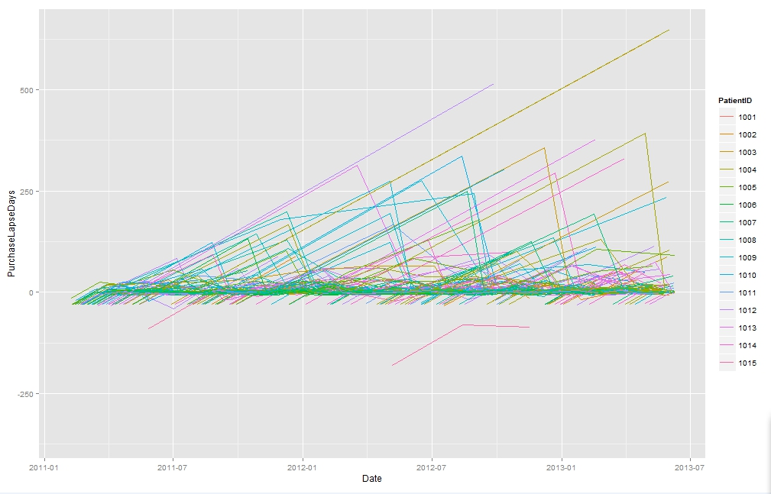
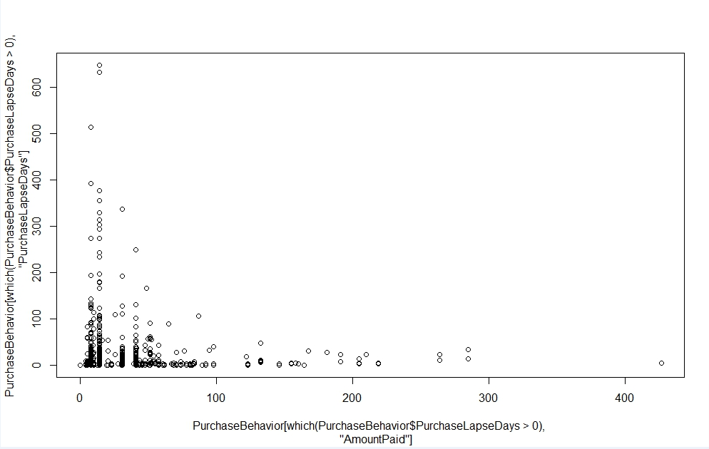
Adherence Behavior – Plots
Purchase lapse date vs all date behavior
Purchase lapse days vs amount paid

Slide 16
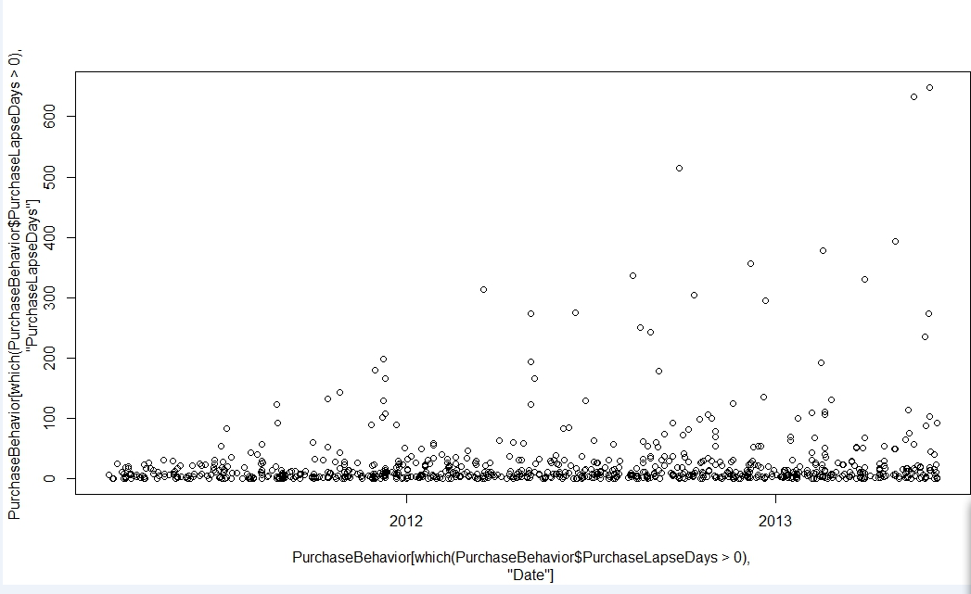
Adherence Behavior – Plots
Purchase lapse date vs date

Slide 17
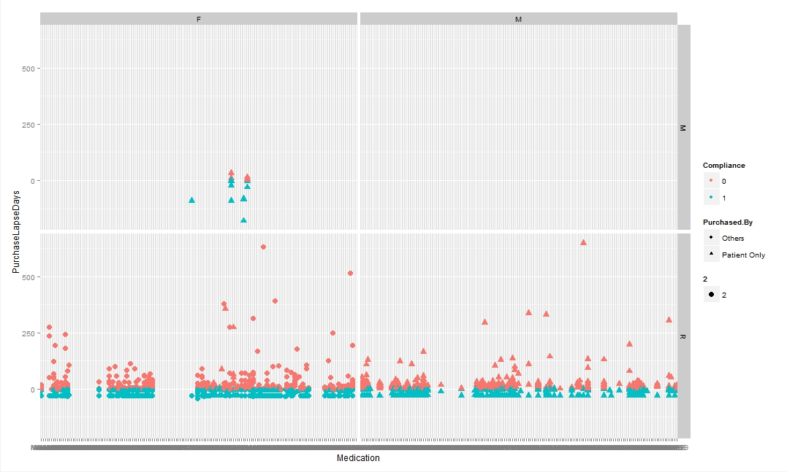
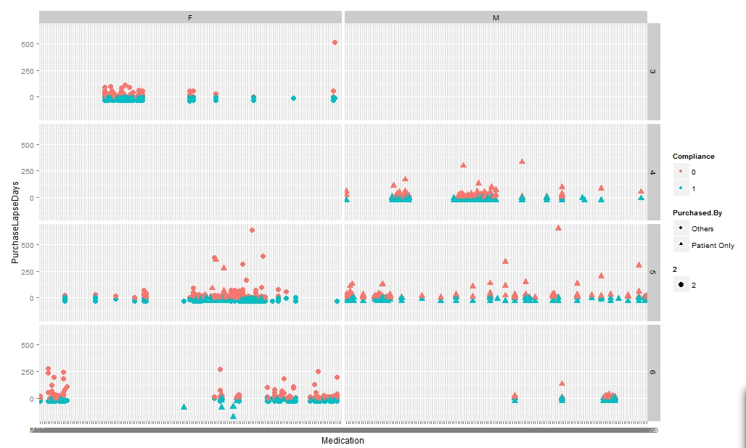
Adherence Behavior – Regression Plots
Regression Plots

